Slide 1

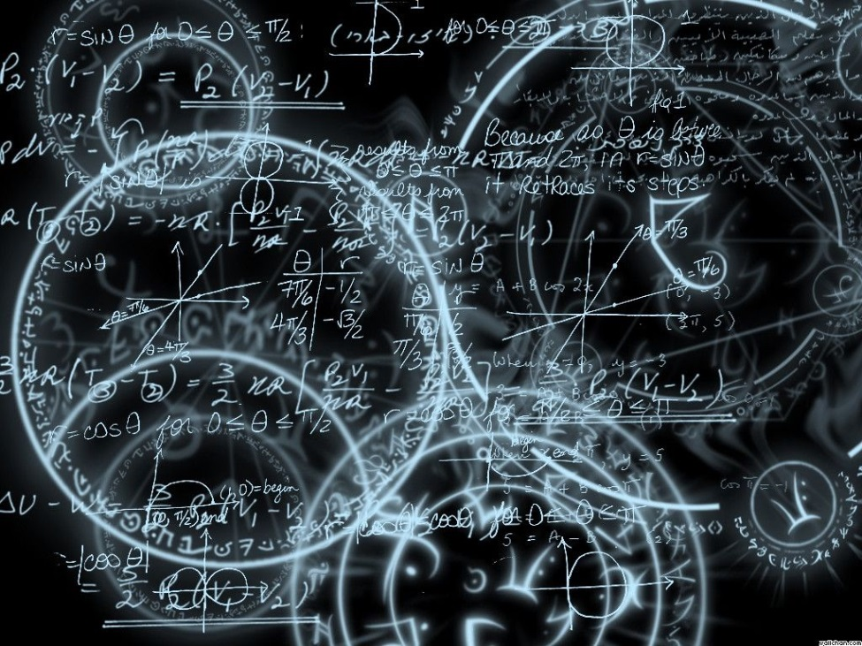
Azərbaycan Dövlət Neft və Sənaye Universiteti
Calculus
Single Variable

Slide 2
Integration:
Introduction

Slide 3
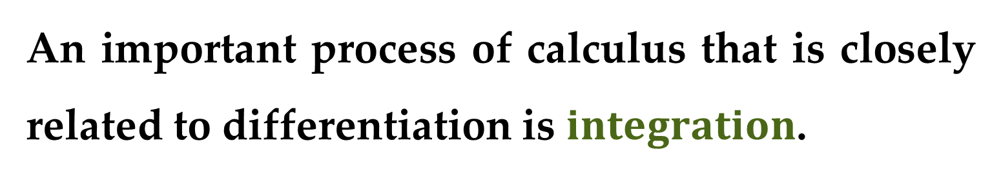
In Calculus I course, we used the tangent and velocity problems to introduce the derivative.
In this course, we use the area and distance problems to introduce the other central idea in calculus — the integral.
An important process of calculus that is closely related to differentiation is $integration$.

Slide 4
The all-important relationship between the derivative and the integral is expressed in the Fundamental Theorem of Calculus, which says that differentiation and integration are in a sense inverse processes.
We learn in this course how integration can be used to solve problems involving volumes, length of curves, population predictions, work, and consumer surplus, among many others.

Slide 5
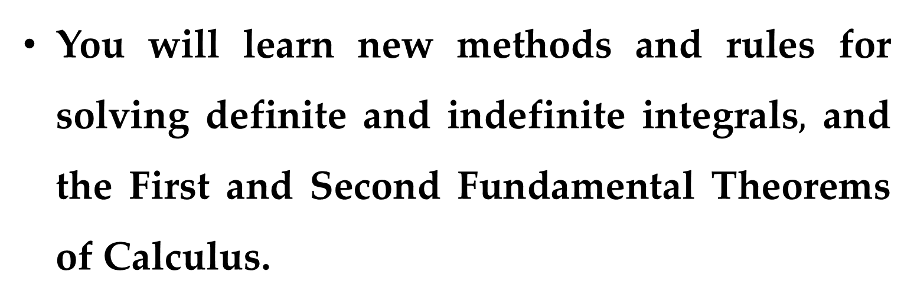
OUTLINE
You will learn new methods and rules for solving definite and indefinite integrals$,$ and the First and Second Fundamental Theorems of Calculus.
Then you will apply these rules to find such things as the position function for an object and the average value of a function.

Slide 6
Integration:
Antiderivatives

Slide 7
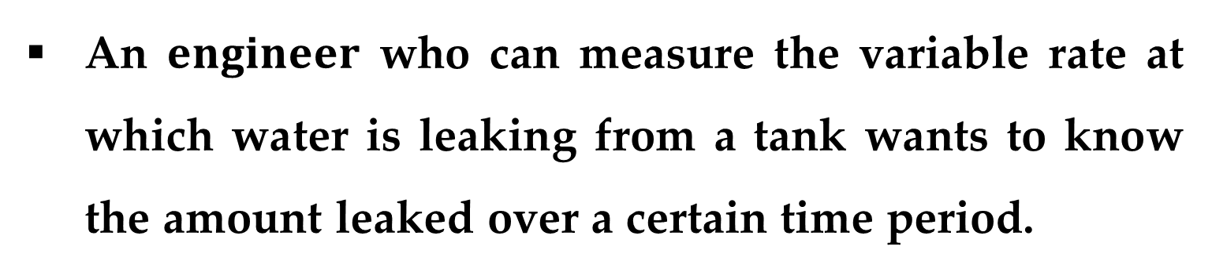
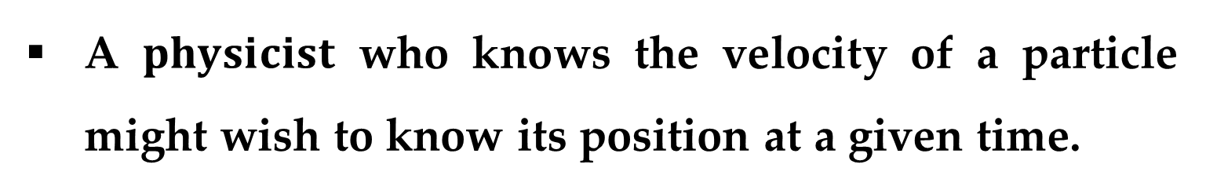
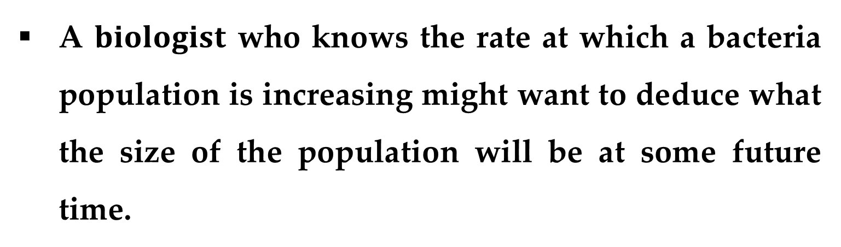
A $physicist$ who knows the velocity of a particle might wish to know its position at a given time.
An $engineer$ who can measure the variable rate at which water is leaking from a tank wants to know the amount leaked over a certain time period.
A $biologist$ who knows the rate at which a bacteria population is increasing might want to deduce what the size of the population will be at some future time.

Slide 8
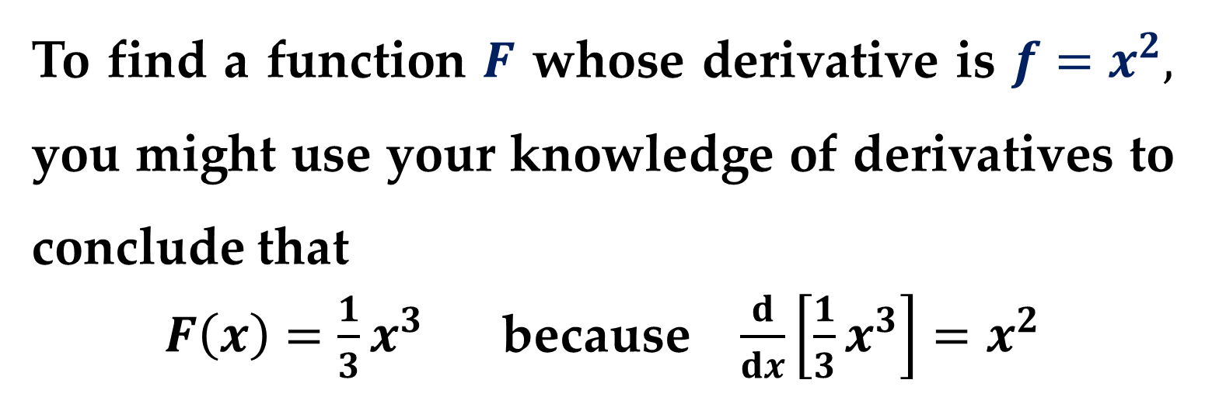
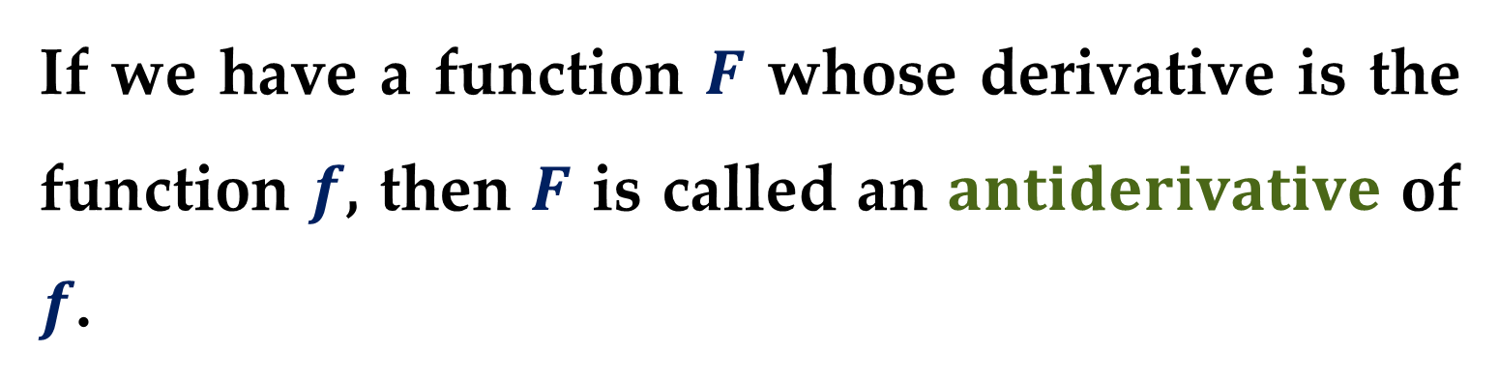
In each case, the problem is to find a function whose derivative is a known function.
If we have a function $F$ whose derivative is the function $f$, then $F$ is called an $antiderivative$ of $f$.
To find a function $F$ whose derivative is $f=x^{2},$ you might use your knowledge of derivatives to conclude that
$F\left(x\right)=\frac{1}{3}x^{3}$ because $\frac{d}{dx}\left[\frac{1}{3}x^{3}\right]=x^{2}$

Slide 9
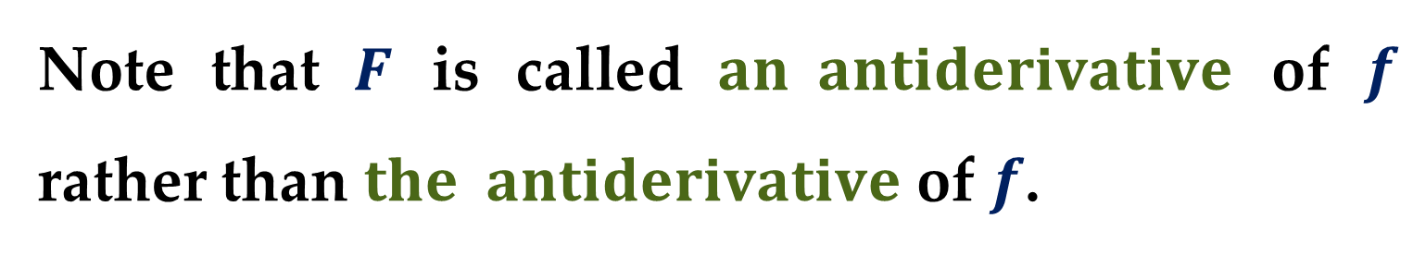
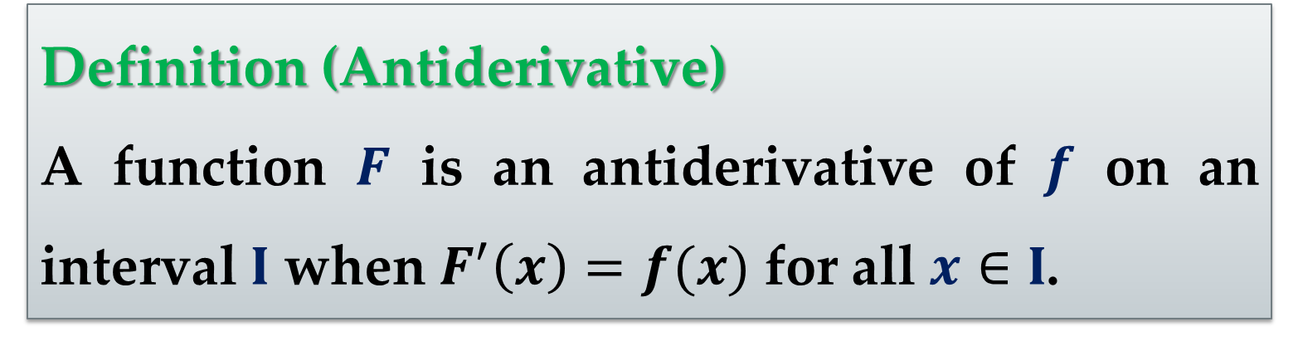
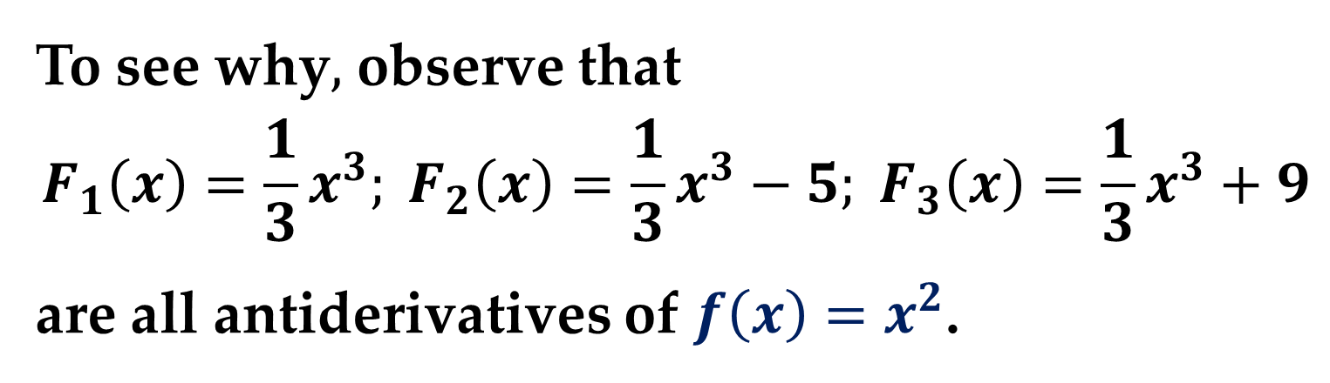
Definition (Antiderivative)
A function $F$ is an antiderivative of $f$ on an interval $I$ when $F^{′}\left(x\right)=f(x)$ for all $x∈I$.
Note that $F$ is called $an antiderivative$ of $f$ rather than $the antiderivative$ of $f$.
To see why$,$ observe that
$$F_{1}\left(x\right)=\frac{1}{3}x^{3}; F_{2}\left(x\right)=\frac{1}{3}x^{3}−5; F_{3}\left(x\right)=\frac{1}{3}x^{3}+9$$
are all antiderivatives of $f\left(x\right)=x^{2}$.

Slide 10
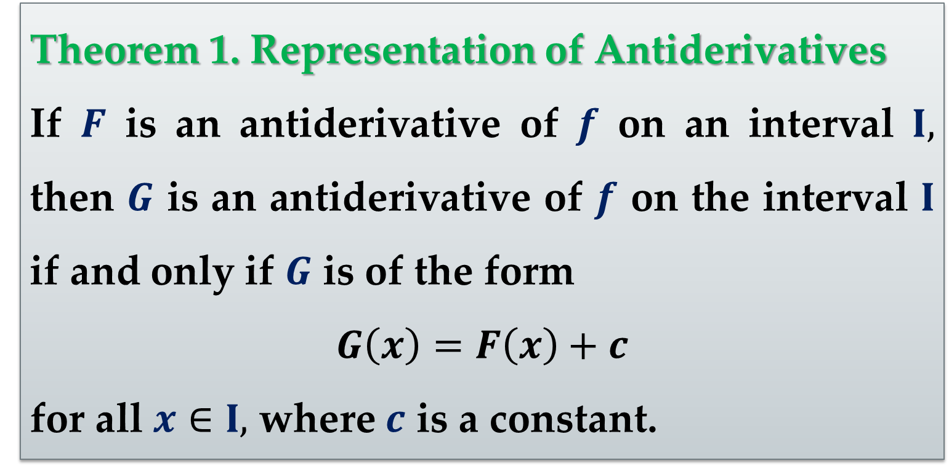
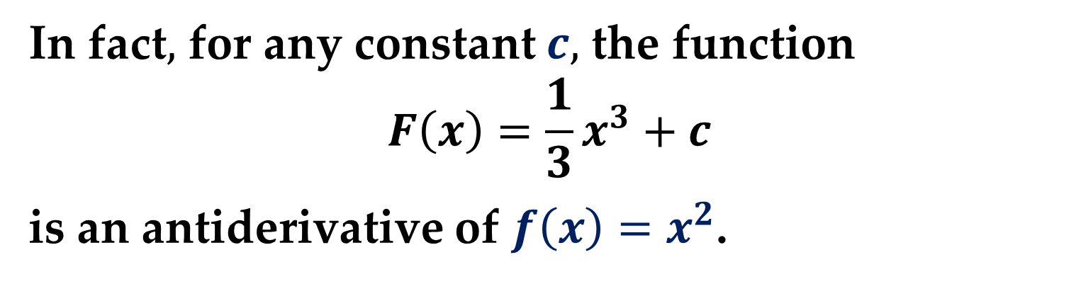
In fact$,$ for any constant $c,$ the function
$$F\left(x\right)=\frac{1}{3}x^{3}+c$$
is an antiderivative of $f\left(x\right)=x^{2}$.
Theorem 1. Representation of Antiderivatives
If $F$ is an antiderivative of $f$ on an interval $I,$ then $G$ is an antiderivative of $f$ on the interval $I$ if and only if $G$ is of the form
$$G\left(x\right)=F\left(x\right)+c$$
for all $x∈I,$ where $c$ is a constant.

Slide 11
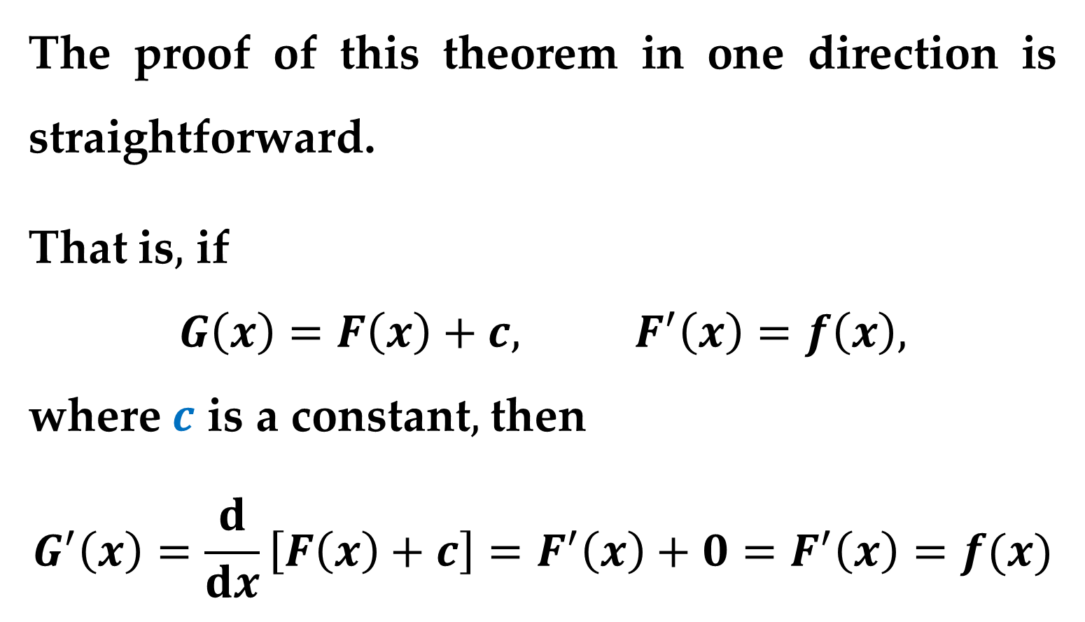
Proof
The proof of this theorem in one direction is straightforward.
That is$,$ if
$$G\left(x\right)=F\left(x\right)+c, F^{′}\left(x\right)=f\left(x\right),$$
where $c$ is a constant$,$ then
$$G^{′}\left(x\right)=\frac{d}{dx}\left[F\left(x\right)+c\right]=F^{′}\left(x\right)+0=F^{′}\left(x\right)=f(x)$$

Slide 12

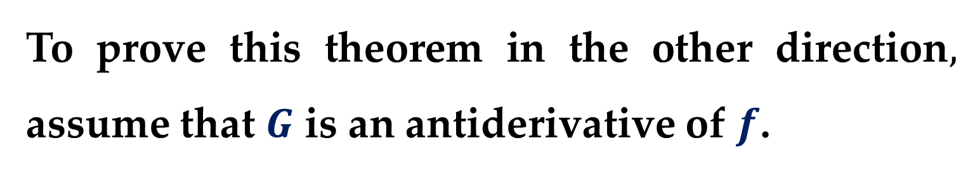
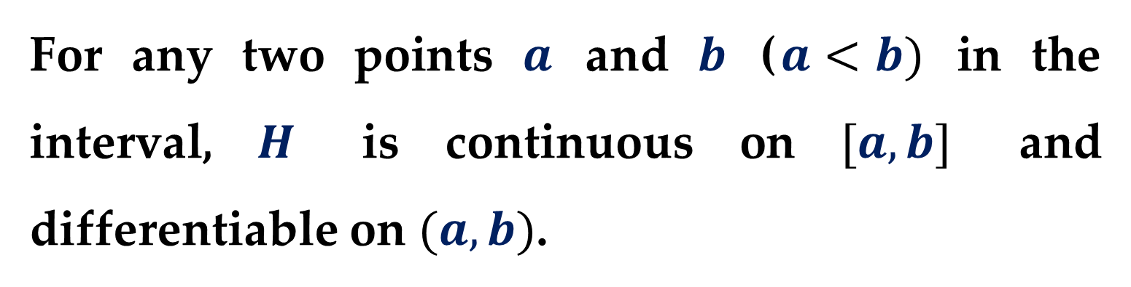
Proof (continued)
To prove this theorem in the other direction$,$ assume that $G$ is an antiderivative of $f$.
Let$’$s define a function $H$ such that
$$H\left(x\right)=G\left(x\right)−F(x)$$
For any two points $a$ and $b$ ($a<b)$ in the interval, $H$ is continuous on $[a,b]$ and differentiable on $(a,b)$.

Slide 13
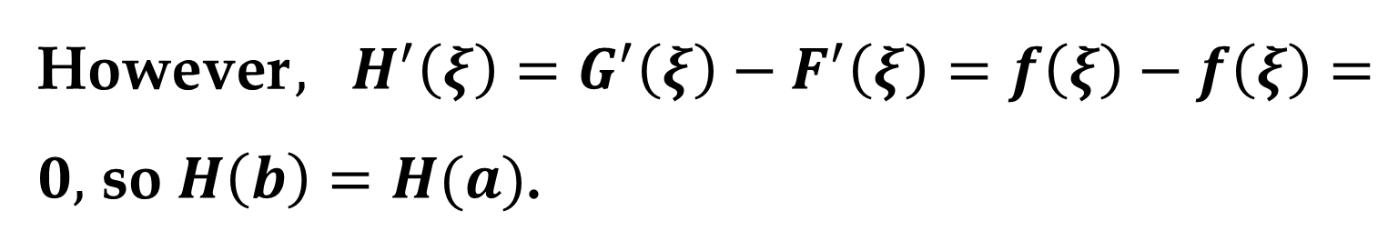
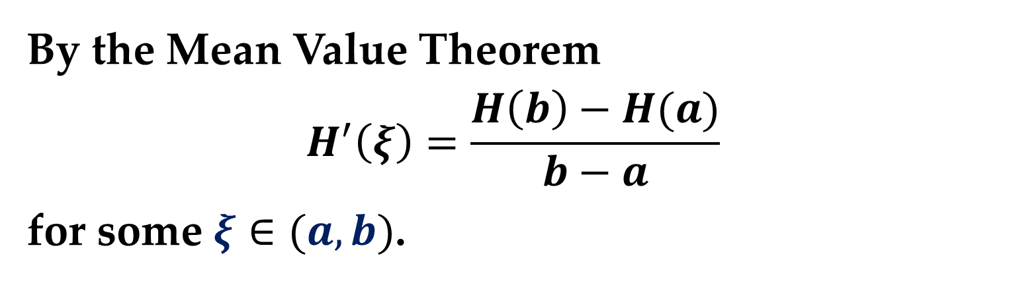
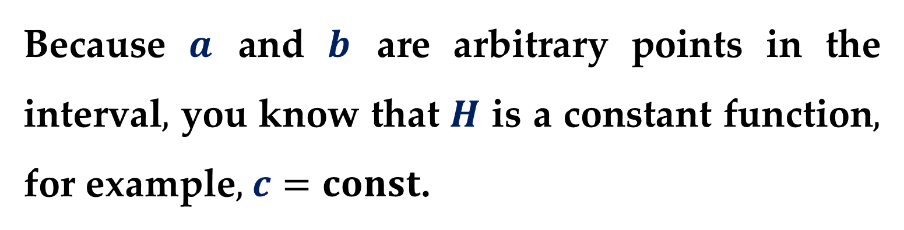
Proof (continued)
By the Mean Value Theorem
$$H^{′}\left(ξ\right)=\frac{H\left(b\right)−H(a)}{b−a}$$
for some $ξ∈(a,b)$.
However$,$ $H^{′}\left(ξ\right)=G^{′}\left(ξ\right)−F^{′}\left(ξ\right)=f\left(ξ\right)−f\left(ξ\right)=0,$ so $H\left(b\right)=H(a)$.
Because $a$ and $b$ are arbitrary points in the interval$,$ you know that $H$ is a constant function$,$ for example$,$ $c=const$.

Slide 14
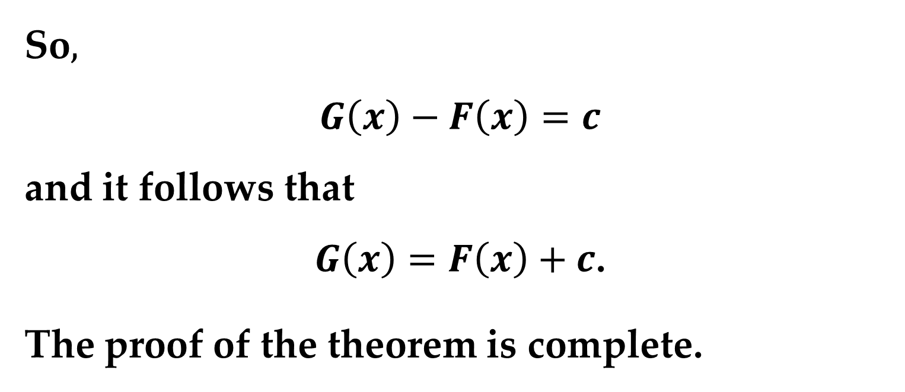
Proof (continued)
So$,$
$$G\left(x\right)−F\left(x\right)=c$$
and it follows that
$G\left(x\right)=F\left(x\right)+c$.
The proof of the theorem is complete.

Slide 15
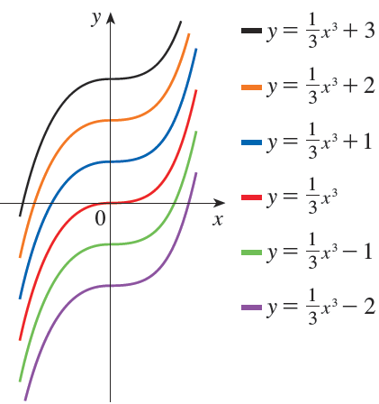
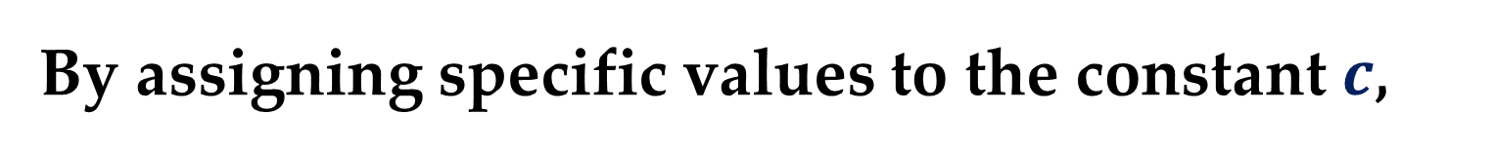
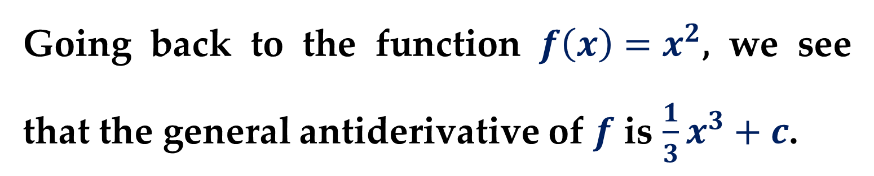
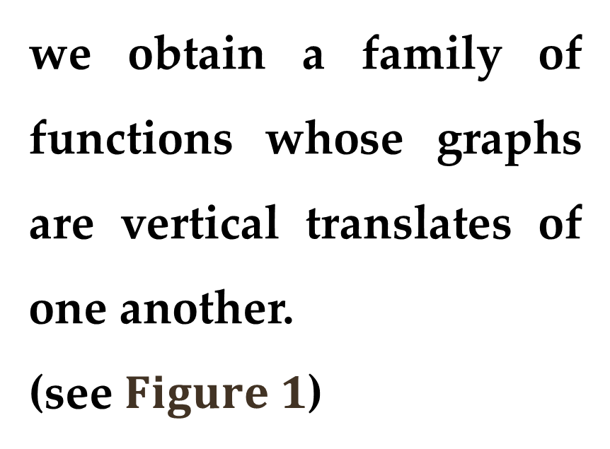
Going back to the function $f\left(x\right)=x^{2}$, we see that the general antiderivative of $f$ is $\frac{1}{3}x^{3}+c$.
By assigning specific values to the constant $c$,
we obtain a family of functions whose graphs are vertical translates of one another.
(see $Figure 1$)

Slide 16
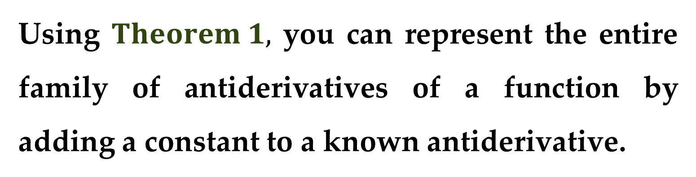
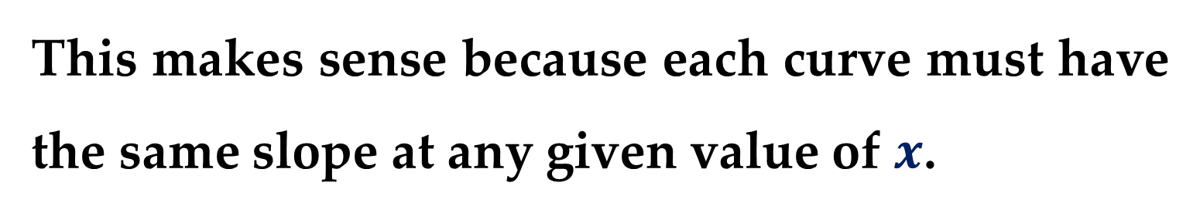
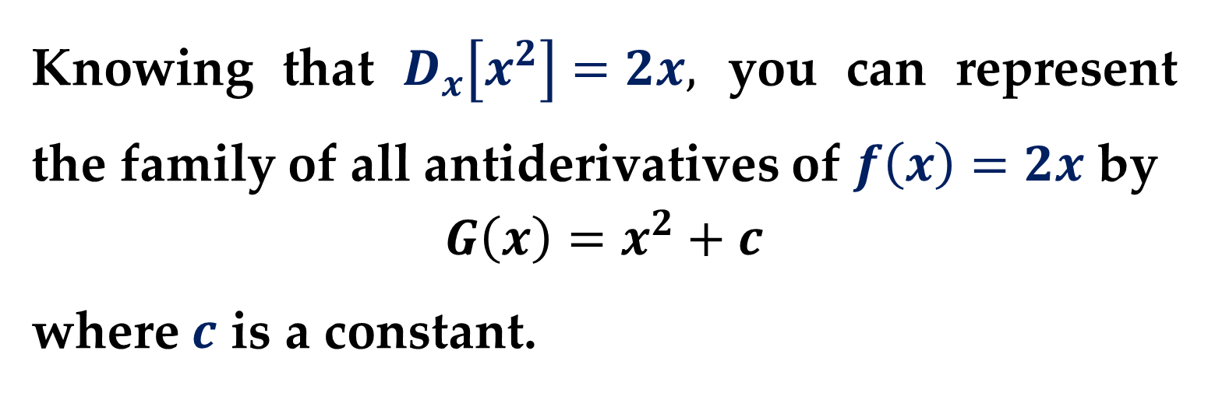
This makes sense because each curve must have the same slope at any given value of $x$.
Using $Theorem 1,$ you can represent the entire family of antiderivatives of a function by adding a constant to a known antiderivative.
Knowing that $D_{x}\left[x^{2}\right]=2x,$ you can represent the family of all antiderivatives of $f\left(x\right)=2x$ by
$$G\left(x\right)=x^{2}+c$$
where $c$ is a constant.

Slide 17
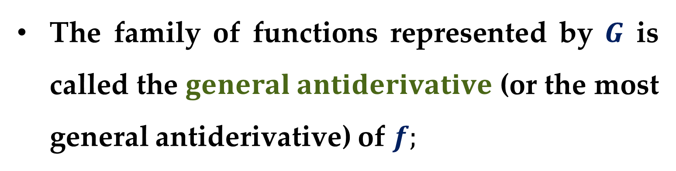
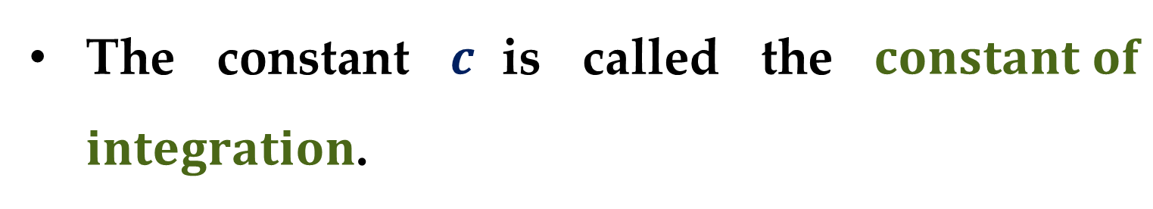
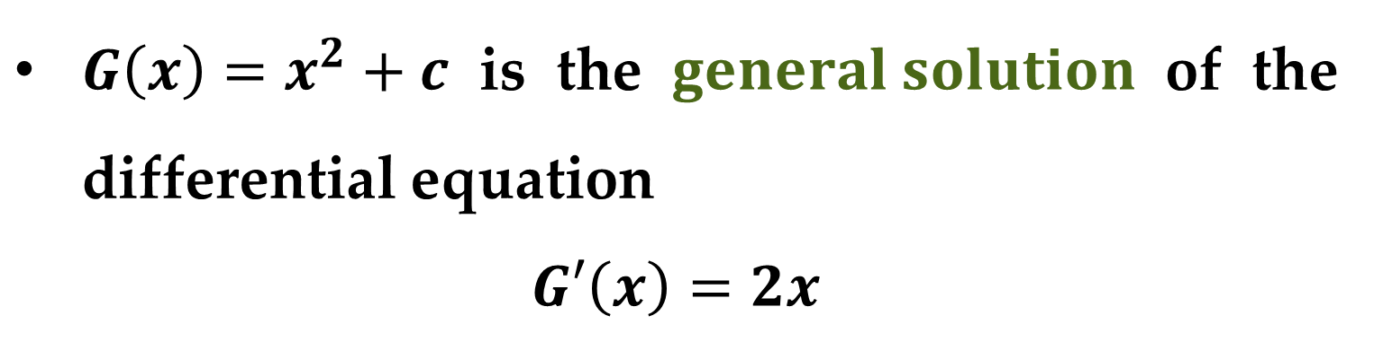
The constant $c$is called the $constant of$ $integration$.
The family of functions represented by $G$ is called the $general antiderivative$ (or the most general antiderivative) of $f;$
$G\left(x\right)=x^{2}+c$ is the $general solution$ of the differential equation
$$G′\left(x\right)=2x$$

Slide 18
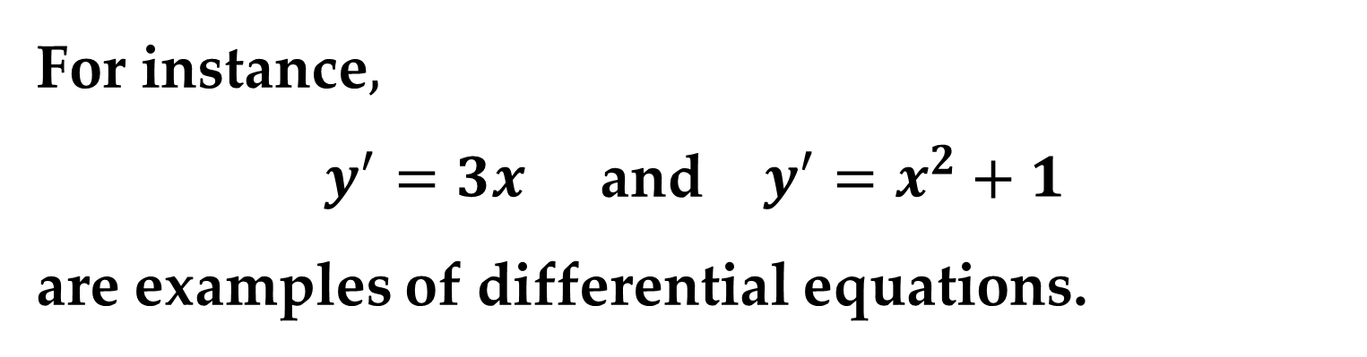
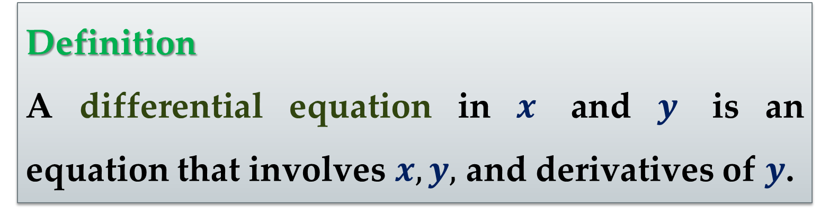
Definition
A differential equation in $x$ and $y$ is an equation that involves $x,y,$ and derivatives of $y$.
For instance$,$
$y^{′}=3x$ and $y^{′}=x^{2}+1$
are examples of differential equations.

Slide 19
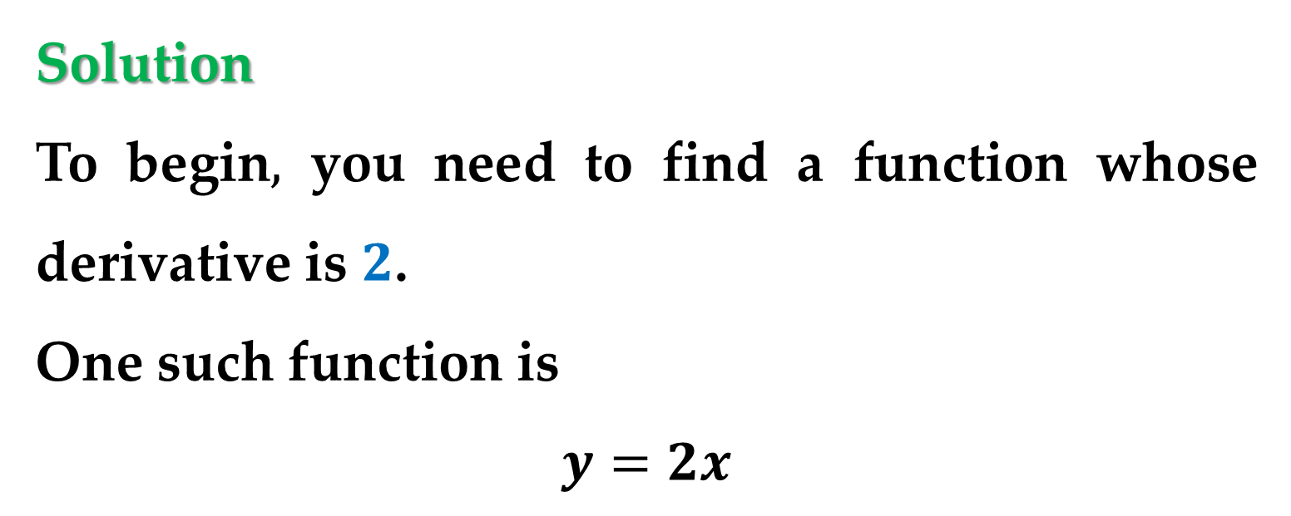
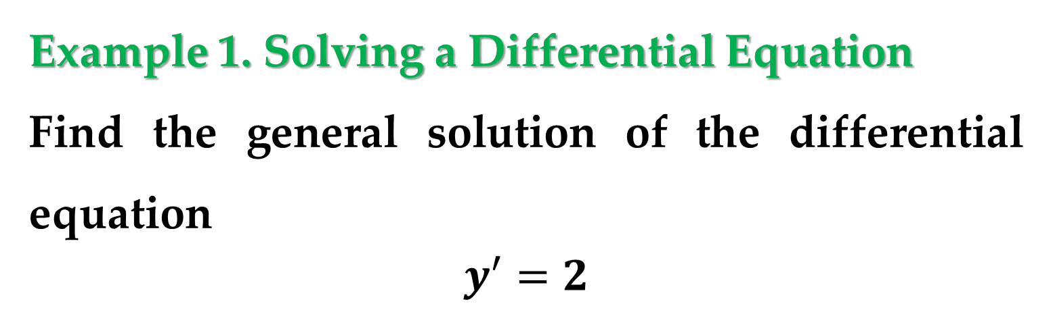
Example 1. Solving a Differential Equation
Find the general solution of the differential equation
$$y^{′}=2$$
Solution
To begin$,$ you need to find a function whose derivative is $2$.
One such function is
$$y=2x$$

Slide 20
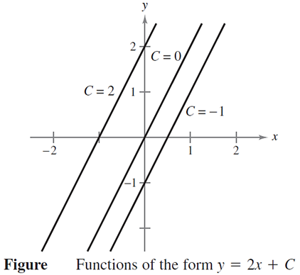
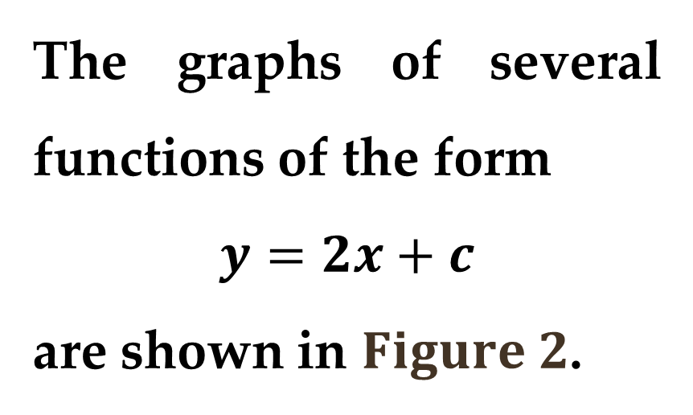
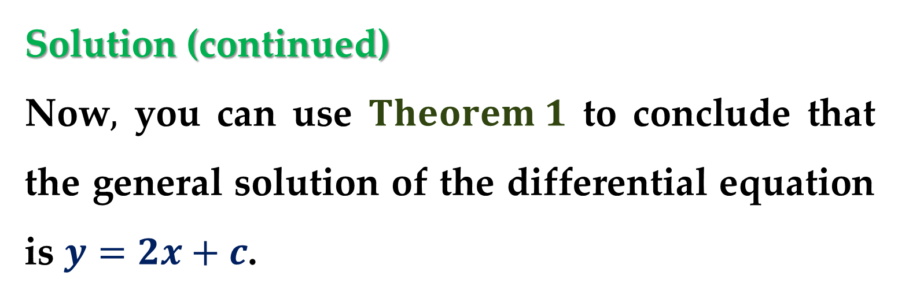
Solution (continued)
Now$,$ you can use $Theorem 1$ to conclude that the general solution of the differential equation is $y=2x+c$.
The graphs of several functions of the form
$$y=2x+c$$
are shown in $Figure 2$.

Slide 21
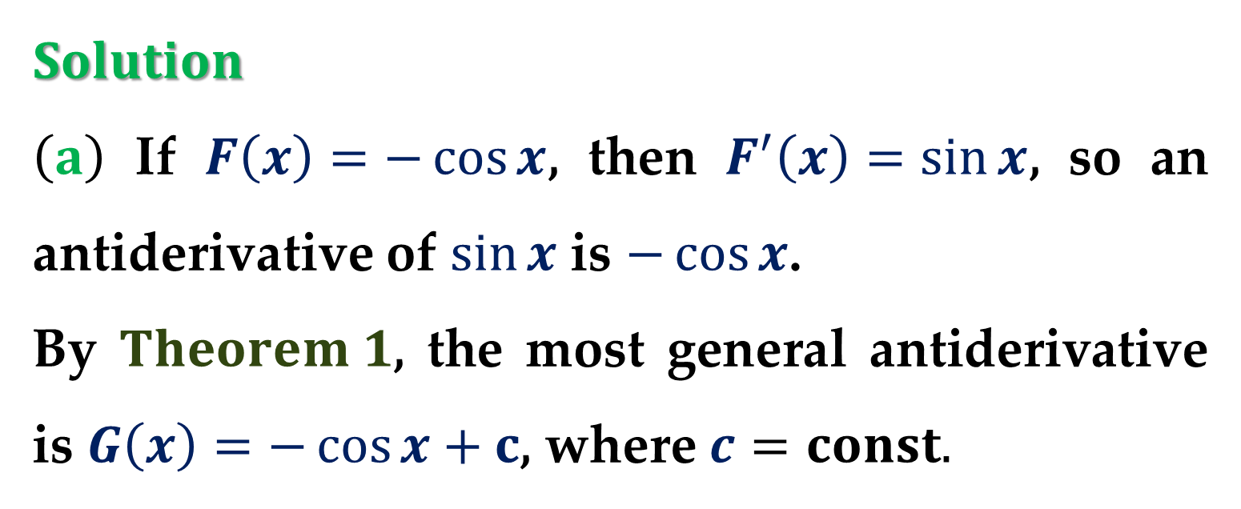
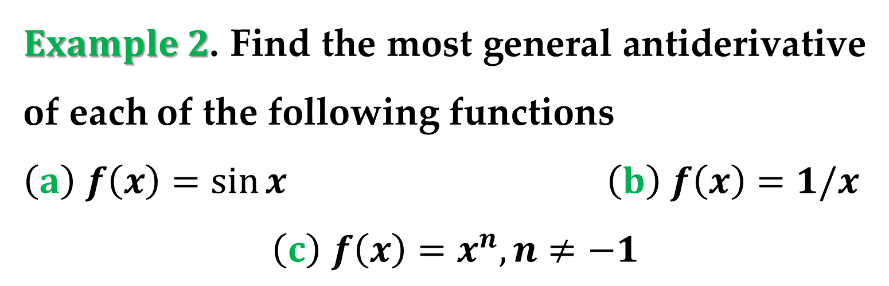
$Example 2$. Find the most general antiderivative of each of the following functions
$\left(a\right)$ $f\left(x\right)=\sin{x}$ $\left(b\right)$ $f\left(x\right)=1/x$
$\left(c\right)$ $f\left(x\right)=x^{n}, n≠−1$
$Solution$
$\left(a\right)$ If $F\left(x\right)=−\cos{x}$, then $F^{′}\left(x\right)=\sin{x}$, so an antiderivative of $\sin{x}$ is $−\cos{x}$.
By $Theorem 1$, the most general antiderivative is $G\left(x\right)=−\cos{x}+c$, where $c=const.$

Slide 22
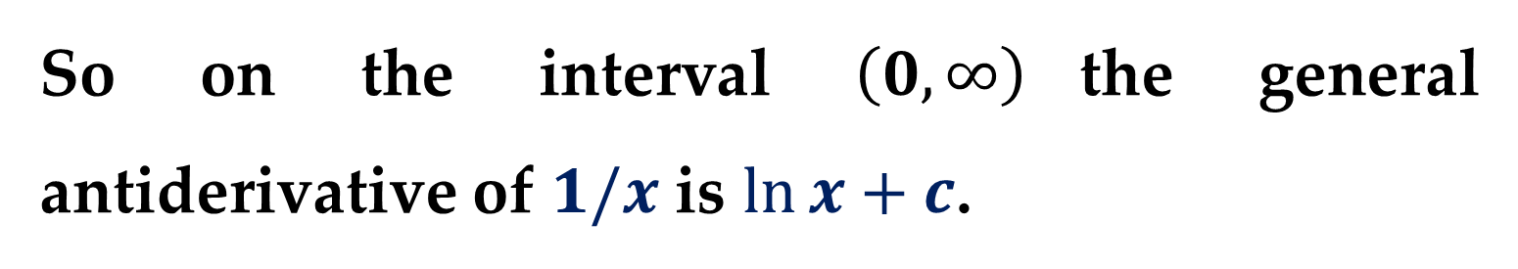
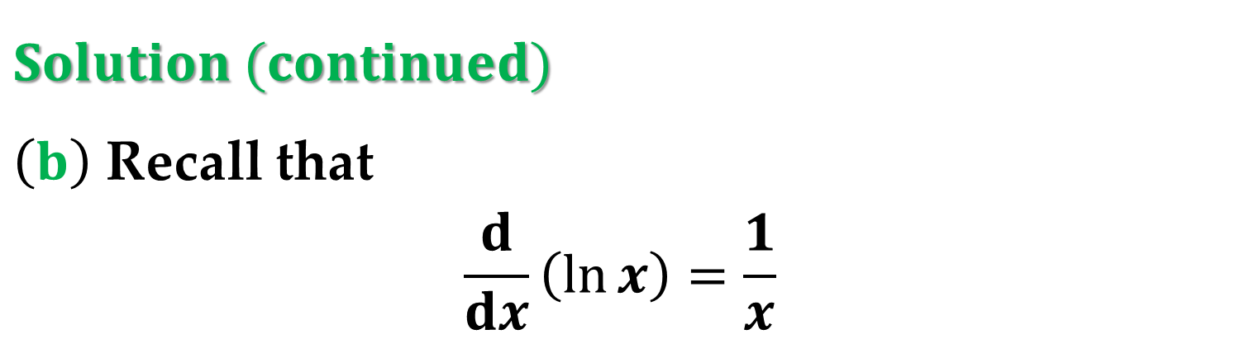
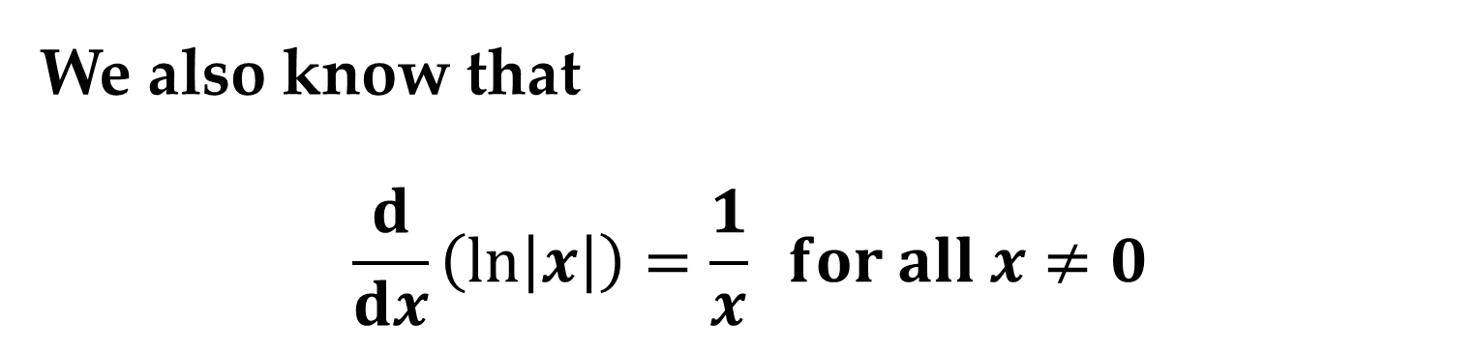
$Solution (continued)$
$\left(b\right)$ Recall that
$$\frac{d}{dx}\left(\ln{x}\right)=\frac{1}{x}$$
So on the interval $\left(0,∞\right)$the general antiderivative of $1/x$ is $\ln{x}+c$.
We also know that
$$\frac{d}{dx}\left(\ln\left|x\right|\right)=\frac{1}{x} for all x≠0$$

Slide 23
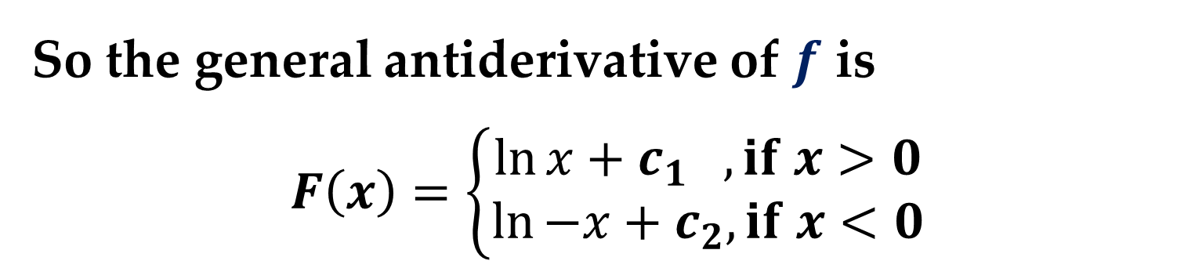
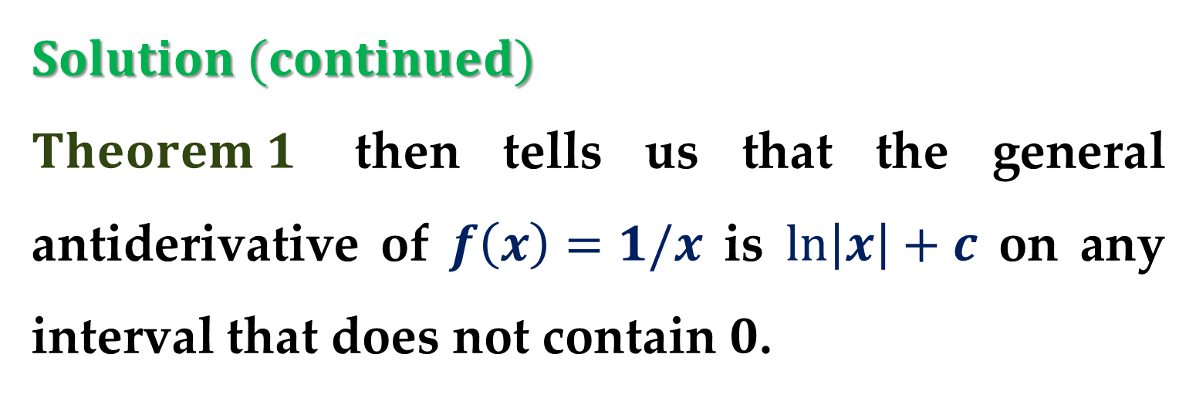
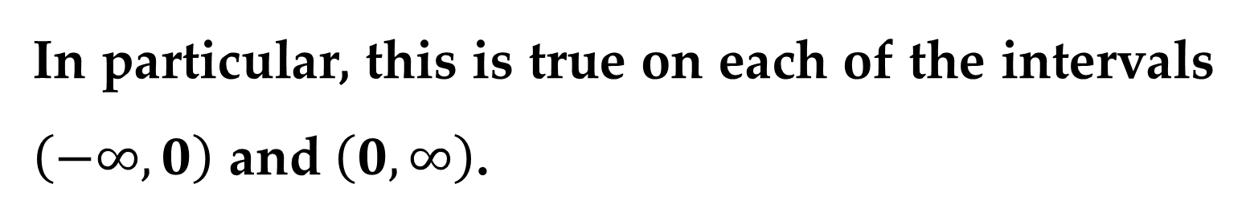
$Solution (continued)$
$Theorem 1$ then tells us that the general antiderivative of $f\left(x\right)=1/x$ is $\ln\left|x\right|+c$ on any interval that does not contain $0$.
In particular, this is true on each of the intervals $\left(−∞,0\right)$ and $\left(0,∞\right)$.
So the general antiderivative of $f$ is
$$F\left(x\right)=\left\{\begin{aligned}\ln{x}+c_{1} , if x>0 \\ \ln{−x}+c_{2}, if x<0\end{aligned}\right.$$

Slide 24
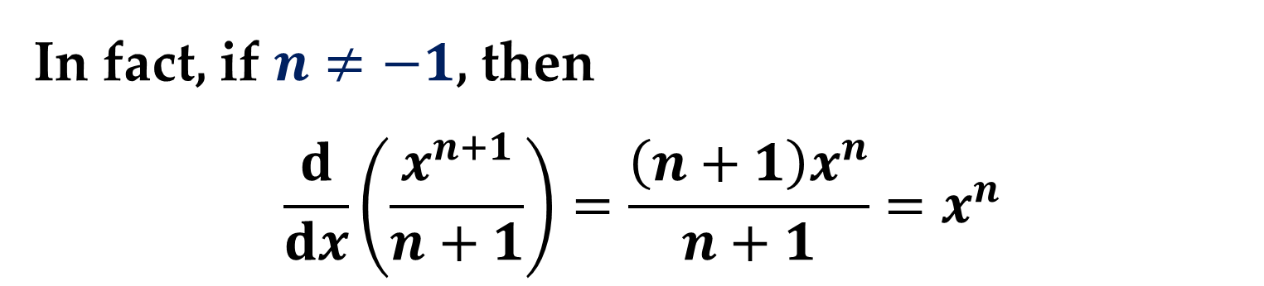
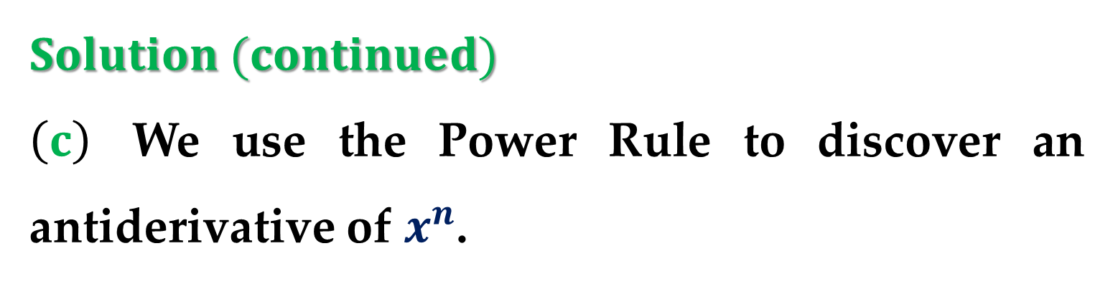
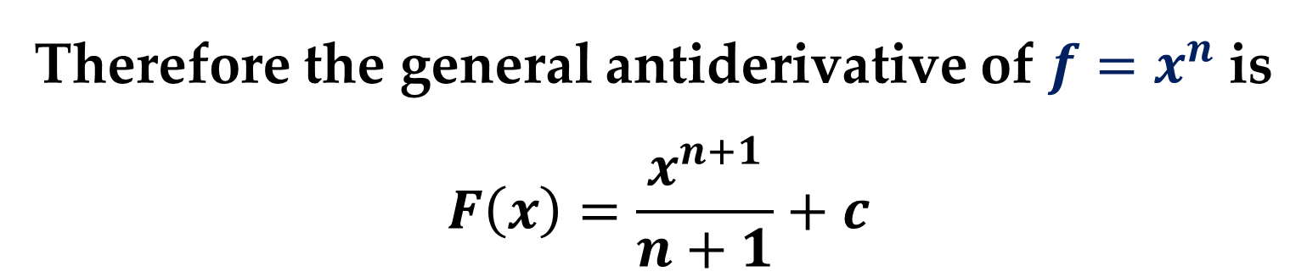
$Solution (continued)$
$\left(c\right)$ We use the Power Rule to discover an antiderivative of $x^{n}$.
In fact, if $n≠−1$, then
$$\frac{d}{dx}\left(\frac{x^{n+1}}{n+1}\right)=\frac{\left(n+1\right)x^{n}}{n+1}=x^{n}$$
Therefore the general antiderivative of $f=x^{n}$ is
$$F\left(x\right)=\frac{x^{n+1}}{n+1}+c$$

Slide 25
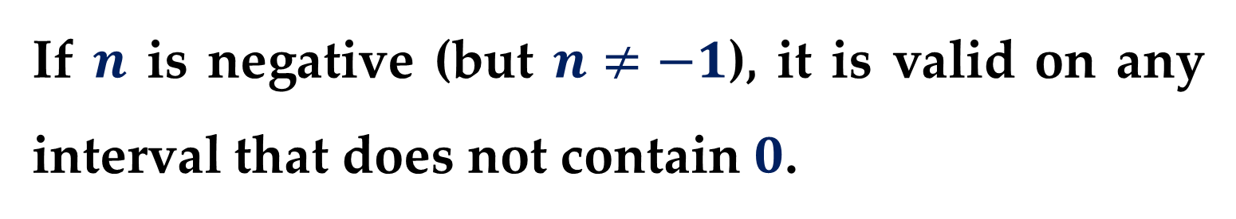
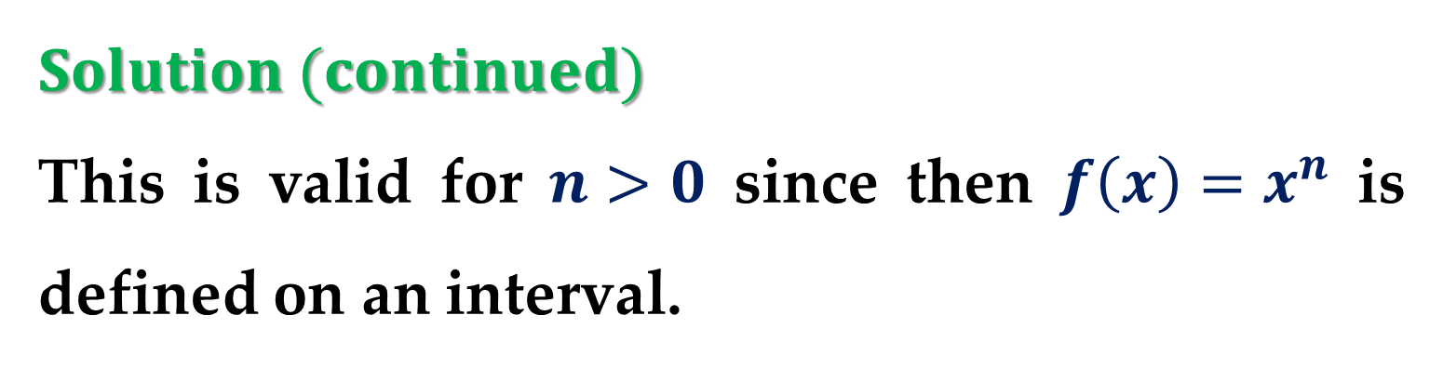
$Solution (continued)$
This is valid for $n>0$ since then $f\left(x\right)=x^{n}$ is defined on an interval.
If $n$ is negative (but $n≠−1$), it is valid on any interval that does not contain $0$.

Slide 26

When solving a differential equation of the form
$$\frac{dy}{dx}=f\left(x\right)$$
it is convenient to write it in the equivalent differential form $dy=f\left(x\right)dx$.
The operation of finding all solutions of this equation is called antidifferentiation (indefinite integration) and is denoted by an integral sign ∫.

Slide 27




The general solution is denoted by
$$y=\int{f\left(x\right)dx}=F\left(x\right)+c$$
Variable of integration
Constant of
integration
An antiderivative
of $f(x)$
Integrand
The expression $\int{f\left(x\right)dx}$ is read as the antiderivative of $f$ with respect to $x$.
So$,$ the differential $dx$ serves to identify $x$ as the variable of integration.

Slide 28
Integration:
Basic Integration Rules

Slide 29


The term $indefinite integral$ is a synonym for antiderivative.
The inverse nature of integration and differentiation can be verified by substituting $F′(x)$ for $f(x)$ in the indefinite integration definition to obtain
$$\int{F^{′}\left(x\right)dx}=F\left(x\right)+C$$

Slide 30

Moreover$,$ if $\int{f\left(x\right)dx}=F\left(x\right)+C,$ then
$$\frac{d}{dx}\left[\int{f\left(x\right)dx}\right]=f(x)$$
These two equations allow you to obtain integration formulas directly from differentiation formulas.

Slide 31


Slide 32




Example 3. Describing Antiderivatives
Describe the antiderivative of $3x$.
Solution
$\int{3x dx}=3\int{x dx}$ Constant multiple rule
$=3\int{x^{1}dx}$ Rewrite $x$ as $x^{1}$
$=3\left(\frac{x^{2}}{2}\right)+c$ Power Rule ($n=1$)
$=\frac{3}{2}x^{2}+c$ Simplify

Slide 33


Remark
In $Example 3,$ note that the general pattern of integration is similar to that of differentiation:

Slide 34

Example 4. Rewriting Before Integrating
Original Rewrite Integrate Simplify
$(a)$ $\int{\frac{1}{x^{3}}dx}$ $\int{x^{−3}dx}$ $\frac{x^{−2}}{−2}+C$ $−\frac{1}{2x^{2}}+C$
$(b)$ $\int{\sqrt{x}dx}$ $\int{x^{\frac{1}{2}}dx}$ $\frac{2}{3}x^{3/2}+C$ $\frac{2}{3}\sqrt{x^{3}}+C$
$(c)$ $\int{2\sin{x}dx}$ $2\int{\sin{x}dx}$ $2\left(−\cos{x}\right)+C$ $−2\cos{x}+C$
Remember that you can check your answer to an antidifferentiation problem by differentiating.

Slide 35


Example 5. Integrating Polynomial Functions
$\left(a\right)$
$$\int{dx}=\int{1dx}=x+c$$
Integrand is understood to be 1.
$\left(b\right)$
$$\int{\left(x+2\right)dx}=\int{xdx}+\int{2dx}=$$
$$=\left[\frac{x^{2}}{2}+C_{1}\right]+\left[2x+C_{2}\right]=$$
$$=\frac{x^{2}}{2}+2x+C$$

Slide 36

Example 5. (continued)
$\left(c\right)$
$$\int{\left(3x^{4} −5x^{2}+x\right)dx}=$$
$$=\int{3x^{4}dx}+\int{−5x^{2}dx}+\int{xdx}=$$
$$=3\left(\frac{x^{5}}{5}\right)−5\left(\frac{x^{3}}{3}\right)+\left(\frac{x^{2}}{2}\right)+c_{1}+c_{2}+c_{3}=$$
$$=\frac{3}{5}x^{5}−\frac{5}{3}x^{3}+\frac{1}{2}x^{2}+c$$
Integrate and Simplify

Slide 37



Example 6. Rewriting Before Integrating
$$\int{\frac{x+1}{\sqrt{x}}dx}=\int{\left(\frac{x}{\sqrt{x}}+\frac{1}{\sqrt{x}}\right)dx}$$
Rewrite as two fractions
$$=\int{\left(x^{1/2}+x^{−1/2}\right)dx}$$
Rewrite with fractional exponents
$$=\frac{x^{3/2}}{\frac{3}{2}}+\frac{x^{1/2}}{\frac{1}{2}}+c=…$$
Integrate

Slide 38

Example 6. (continued)
$$=\frac{2}{3}x^{3/2}+2x^{1/2}+c=$$
$$=\frac{2}{3}\sqrt{x}\left(x+3\right)+c$$
Simplify

Slide 39


Example 7. Rewriting Before Integrating
$$\int{\frac{\sin{x}}{\cos^{2}{x}}dx}=\int{\left(\frac{1}{\cos{x}}\right)\left(\frac{\sin{x}}{\cos{x}}\right)dx}$$
Rewrite as a product
$$=\int{\sec{x}∙\tan{x}dx}=\sec{x}+c$$
Rewrite using trigonometric identities and Integrate

Slide 40
Be sure you realize that one of the most important steps in integration is rewriting the integrand in a form that fits the basic integration rules.

Slide 41


Example 8. Rewriting Before Integrating
$(a)$ $\int{\frac{2}{\sqrt{x}}dx}\overset{→}{rewrite}2\int{x^{−\frac{1}{2}}dx}\overset{→}{integrate}2\left(\frac{x^{\frac{1}{2}}}{\frac{1}{2}}\right)\overset{→}{simplify}4x^{\frac{1}{2}}+c$
$(b)$ $\int{{\left(t^{2}+1\right)}^{2}dt}\overset{→}{rewrite}\int{\left(t^{4}+2t^{2}+1\right)dt}\overset{→}{integrate}\frac{t^{5}}{5}+2\frac{t^{3}}{3}+t+c$
$$\overset{→}{simplify}\frac{1}{5}t^{5}+\frac{2}{3}t^{3}+t+c$$

Slide 42


Example 8. (continued)
$(c)$ $\int{\frac{x^{3}+3}{x^{2}}dx}\overset{→}{rewrite} \int{\left(x+3x^{−2}\right)dx}\overset{→}{integrate}\frac{x^{2}}{2}+3\left(\frac{x^{−1}}{−1}\right)+c$
$$\overset{→}{simplify}\frac{1}{2}x^{2}−\frac{3}{x}+c$$
$(d)$ $\int{\sqrt[3]{x}\left(x−4\right)dx}\overset{→}{rewrite} \int{\left(x^{\frac{4}{3}}−4x^{\frac{1}{3}}\right)dx}\overset{→}{integrate}\frac{x^{\frac{7}{3}}}{\frac{7}{3}}−4\left(\frac{x^{\frac{4}{3}}}{\frac{4}{3}}\right)+c$
$$\overset{→}{simplify}\frac{3}{7}x^{\frac{7}{3}}−3x^{\frac{4}{3}}+c$$

Slide 43
Integration:
Initial Conditions and Particular Solutions

Slide 44


You have already seen that the equation
$$y=\int{f\left(x\right)dx}$$
has many solutions (each differing from the others by a constant of integration).
What does this mean geometrically?
This means that the graphs of any two antiderivatives of $f\left(x\right)$ are vertical translations of each other.

Slide 45



For example$,$ $Figure 3$ shows the graphs of several antiderivatives of the form
$$y=\int{\left(3x^{2}−1\right)dx}=$$
$$=x^{3}−x+c$$
general solution
for various values of $c$.

Slide 46



Each of these antiderivatives is a solution of the differential equation
$$\frac{dy}{dx}=3x^{2}−1$$
In many applications of integration$,$ you are given enough information to determine a $particular solution$.
To do this$,$ you need only know the value of $y=F(x)$ for one value of $x$.

Slide 47



This information is called an $initial condition$.
For example$,$ in $Figure 3$ above, only one curve passes through the point $\left(2,4\right)$.
To find the curve that passes through the point $\left(2,4\right),$ you can use the general solution:
$F\left(x\right)=x^{3}−x+c$ General solution
and the initial condition
$F\left(2\right)=4$ Initial condition

Slide 48


By using the initial condition in the general solution$,$ you can determine that
$$F\left(2\right)=2^{3}−2+c=4$$
which implies that $c=−2$.
So$,$ you obtain
$F\left(x\right)=x^{3}−x−2$ Particular solution

Slide 49


Example 9. Finding a Particular Solution
Find the general solution of
$$F′\left(x\right)=\frac{1}{x^{2}}, x>0$$
and find the particular solution that satisfies the initial condition $F\left(1\right)=0$.
Solution
$$F\left(x\right)=\int{\frac{1}{x^{2}}dx}=\int{x^{−2}dx}=…$$

Slide 50


Solution (continued)
$$=\frac{x^{−1}}{−1}+c=−\frac{1}{x}+c, x>0$$
Rewrite as a power and Integrate
Using the initial condition $F\left(1\right)=0,$ you can solve for $c$ as follows:
$F\left(1\right)=−\frac{1}{1}+c=0 →$ $c=1$

Slide 51


Solution (continued)
So$,$ the particular solution$,$ as shown in $Figure 4,$ is
$F\left(x\right)=−\frac{1}{x}+1, x>0$
Particular solution

Slide 52

Antidifferentiation is particularly useful in analyzing the motion of an object moving in a straight line.
Recall that if the object has position function $s=f\left(t\right)$, then the velocity function is $v\left(t\right)=s^{′}\left(t\right)$.
This means that the position function is an antiderivative of the velocity function.

Slide 53


Likewise, the acceleration function is $a\left(t\right)=v^{′}\left(t\right),$ so the velocity function is an antiderivative of the acceleration.
If the acceleration and the initial values $s\left(0\right)$ and $v\left(0\right)$ are known, then the position function can be found by antidifferentiating twice.

Slide 54



$Example 10.$
A particle moves in a straight line and has acceleration given by
$$a\left(t\right)=6t+4$$
Its initial velocity is $v\left(0\right)=−6 cm/s$ and its initial displacement is $s\left(0\right)=9 cm$.
Find its position function $s\left(t\right)$.

Slide 55


$Solution$
Since $v^{′}\left(t\right)=a\left(t\right)=6t+4$, antidifferentiation gives
$$v\left(t\right)=6\frac{t^{2}}{2}+4t+c_{1} →3t^{2}+4t+c_{1}$$
Note that $v\left(0\right)=c_{1}$. But we are given that $v\left(0\right)=−6$, so $c_{1}=−6$ and
$$v\left(t\right)=3t^{2}+4t−6$$

Slide 56


$Solution (continued)$
Since $v\left(t\right)=s^{′}\left(t\right)$, $s$ is the antiderivative of $v$:
$$s\left(t\right)=3\frac{t^{3}}{3}+4\frac{t^{2}}{2}−6t+c_{2} →t^{3}+2t^{2}−6t+c_{2}$$
This gives $s\left(0\right)=c_{2}$. We are given that $s\left(0\right)=9$, so $c_{2}=9$ and the required position function is
$$s\left(t\right)=t^{3}+2t^{2}−6t+9$$

Slide 57


An object near the surface of the earth is subject to a gravitational force that produces a downward acceleration denoted by $g$.
For motion close to the ground we may assume that $g$ is constant, its value being about $9.8 m/s^{2}$ (or $32 ft/s^{2}$).
It is remarkable that from the single fact that the acceleration due to gravity is constant, we can use calculus to deduce the position and velocity of any object moving under the force of gravity, as illustrated in the next example.

Slide 58


Example 11. Solving a Vertical Motion Problem
A ball is thrown upward with an initial velocity of $64$ feet per second from an initial height of $80$ feet.
$(a)$ Find the position function giving the height as a function of the time $t$.
$(b)$ When does the ball hit the ground?

Slide 59

Solution
$\left(a\right)$ Let $t=0$ represent the initial time.
The two given initial conditions can be written as follows:
$s\left(0\right)=80$ Initial height is 80 feet
$s^{′}\left(0\right)=64$ Initial velocity is 64 feet per second
where $s\left(t\right)$ is the position function of the thrown ball.

Slide 60


Solution (continued)
Using $−32$ feet per second per second as the acceleration due to gravity$,$ you can write:
$$s^{′′}\left(t\right)=−32$$
$$\int{s^{′′}\left(t\right)dt}=s^{′}\left(t\right)=\int{−32dt}=−32t+c_{1}$$
Using the initial velocity$,$ you obtain
$$s^{′}\left(0\right)=64=−32\left(0\right)+c_{1}$$
which implies that $c_{1}=64$.

Slide 61



Solution (continued)
Next$,$ by integrating $s′\left(t\right),$ you obtain
$$\int{s^{′}\left(t\right)dt}=s\left(t\right)=\int{\left(−32t+64\right)dt}=−16t^{2}+64t+c_{2}$$
Using the initial height$,$ you obtain
$$s\left(0\right)=80=−16\left(0^{2}\right)+64\left(0\right)+c_{2}$$
which implies that $c_{2}=80$.
So$,$ the position function is
$$s\left(t\right)=−16t^{2}+64t+80$$

Slide 62


Solution (continued)
$\left(b\right)$ Using the position function found in part $(a),$ you can find the time at which the ball hits the ground by solving the equation $s\left(t\right)=0$:
$$s\left(t\right)=−16t^{2}+64t+80=0$$
$$−16\left(t+1\right)\left(t−5\right)=0$$
$$t=−1; 5$$
Because $t$ must be positive$,$ you can conclude that the ball hits the ground $5$ seconds after it was thrown.

Slide 63


Solution (continued)
The solution to the problem is illustrated in $Figure 5$.

Slide 64

Note
$Example 10$ shows how to use calculus to analyze vertical motion problems in which the acceleration is determined by a gravitational force.
You can use a similar strategy to analyze other linear motion problems (vertical or horizontal) in which the acceleration (or deceleration) is the result of some other force.

Slide 65
Thank you for attention

Slide 66
text
text
text

Slide 67

$Solution (continued)$
text
text
text

